Slide 1
بسم الله الرحمن الرحيم
Behavioural and Social Sciences
Dr. Rayan Ismail Idreis
BDM. NATIONAL UNIVERCITY
MPH INTERNATIONAL UNIVERCITY OF AFRICA

Slide 2
Definition Of behavioral science
behavioral science is the study of why we do what we do. Its aim is to understand as best as possible the mechanisms by which we make the judgments and decisions which inform our behavior.

Slide 3
Definition Of Social Science
Social science is the study of people: as individuals, communities and societies; their behaviors and interactions with each other and with their environments.

Slide 4
Social environment is as important as the physical and biological environment in relation to health and disease in man.

Slide 5
Social Sciences:
5 important social sciences branches include
Sociology
Social anthropology
Social psychology
Economics
Political science
Behavioural
Sciences

Slide 6
The goal of the behavioral and social sciences is to better understand human behaviors and apply this understanding to improving the quality of life for people.

Slide 7
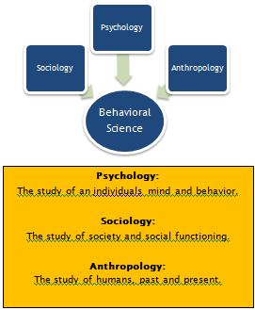

Slide 8
ECONOMICS
Economics is a social science that seeks to analyze and describe the production, distribution, and consumption of wealth

Slide 9
Anthropology
Anthropology is the holistic "science of man," - a science of the totality of human existence.
The discipline deals with the integration of different aspects of the Social Sciences, Humanities, and Human Biology .

Slide 10
Psychology
Psychology derives from two Greek words, “Psyche and Logos”
Literally psychology mean the study of souls but now it is study of mind.
Psychology primarily studies Who and What we are, Why we act and think in a particular manner and what is our potential as an individual.
Study of psychology is concerned with specific study of behavior and mental process.

Slide 11
What is Specific Studies?
They develop theories of human functioning, often developing new approaches to current knowledge.
As a science, psychology uses systematic method to observe, describe, predict and explain human behavior and mental process.

Slide 12
Defining Psychology:
Psychology can be defined as the scientific study of behavior and mental process.
From the word behavior one can extract two meaning, because there are two kind of behavior:
Overt and Covert behavior.

Slide 13
1. Overt behavior :
Are those which is visible to other in other word seen behaviors,
Example: The way we talk, walk, dress, eat and so on…
In short these are the action we see and observe in individual and group around us..
2. Covert behavior :
Are those which is not obvious to the people around us. Simply they are unseen behavior.
Example : Feeling such as anger, jealousy, kindness, pity, happiness and sad.
In fact, covert can be deduced from the overt.

Slide 14
Thanks for attention

